Slide 1
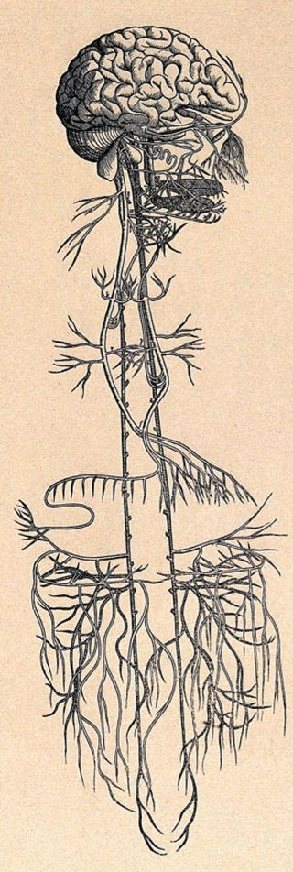
AGNI & THE VAGUS NERVE
“An individual that maintains a balanced state of the main elements of the body, adequate digestions, proper excretion, blissful condition of soul, satisfied senses, and a happy state of mind, is called a healthy person”
Sushruta Samhita – Chapter 15, Verse 41

Slide 2
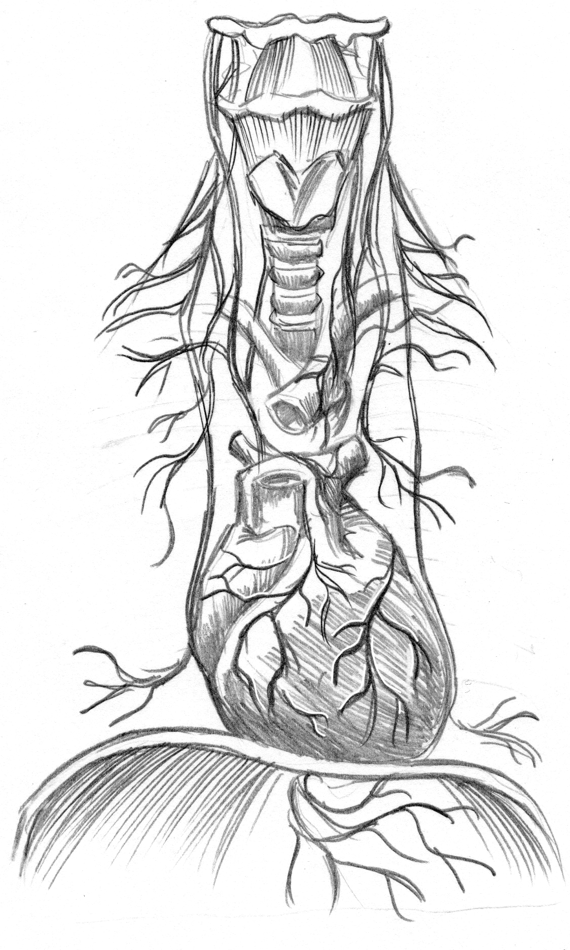
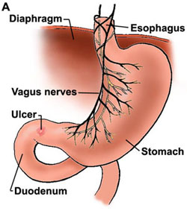
THE AUTONOMIC NERVOUS SYSTEM

Slide 3
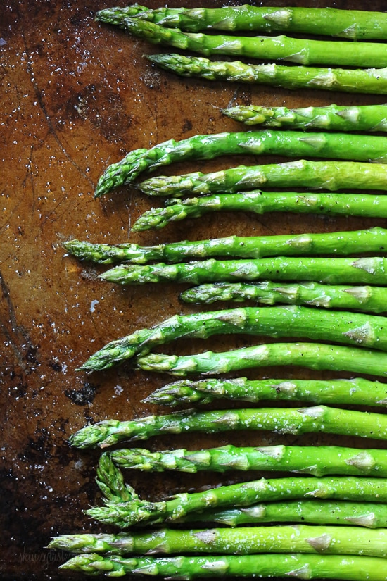
PARASYMPATHETIC

Slide 4
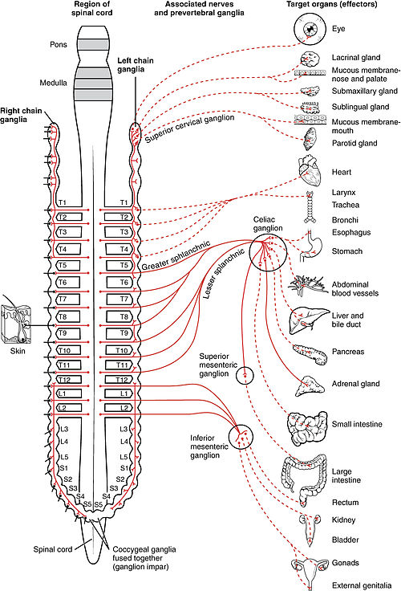
SYMPATHETIC
Fight response aggravates pitta then vata
Flight response aggravates vata then pitta
Freeze response aggravates vata then kapha
AGNI IS REROUTED AWAY FROM DIGESTIVE ORGANS AND TO THE PERIPHARY OF THE BODY AS WELL AS THE SENSE ORGANS

Slide 5
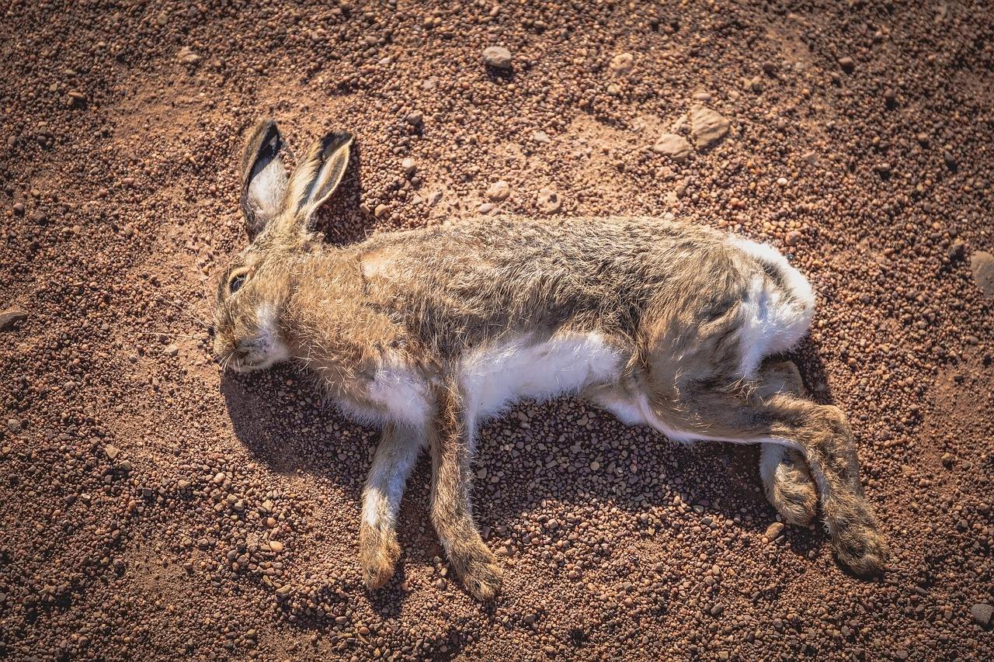
STRESS | IMMOBILIZATION
Physiological responses to non-immediate stresses are largely the same as when you’re fighting for survival. They engage the SYMPATHETIC RESPONSE
When the threat is perceived as undefeatable, and unavoidable, the ANS may engage the immobilization response VIA THE VAGUS NERVE PATHWAYS IN THE PARASYMPATHETIC NERVOUS SYSTEM

Slide 6
CASE STUDY – Mark Johnson
27 year old male
Height: 5’7”
Weight: 77lbs (his highest lifetime weight was 111lbs via use of TPN)
Prakruti: Vata/Pitta
Vikruti: VPK – Mainly vata
Symptoms – Rapid weight loss. Inability to gain weight, swelling in lower limbs, severe anxiety surrounding health, 6 – 8 bowel movements daily, bloating, belching, flatulence, distention of the abdomen, severe weakness, etc.
Ayurvedic Assessment – Grahani
Allopathic Diagnosis – Crohn’s
VISHAMA AGNI → AMA → VPK AGGRIVATION OVER TIME → GRAHANI → DHATU KASHAYA
WHAT CAUSED THE VISHAMA AGNI??????
PERCIEVED HOME AS THREATENING (SPECIFICALLY FATHER) → ENGAGED MAINLY FLIGHT SYMPATHETIC RESPONSE → IMMOBILIZED AT SPECIFIC POINTS → AGNI IS UTILIZED OUTSIDE THE GIT → VISHAMA AGNI

Slide 7
CASE STUDY – LONG STORY SHORT…
After 6 months, Mark Johnson is 117lbs
He has 2 – 4 bowel movements daily
His bloating and belching are almost gone completely
His anxiety has reduced significantly…
…He and his father are conflicting about 90% less frequently

Slide 8
INTERNATIONAL INSTITUTE OF AYURVEDA
AYURVEDIC HEALTH PRACTITIONER PROGRAM
BEGINS JANUARY 2022
AYURVEDA & THE VAGUS NERVE COURSE
BEGINS JANUARY 2022
PULSE UNVEILED COURSE AND BOOK
CURRENTLY AVAILABLE
707.412.0053
victor@iiayurveda.com
www.iiayurveda.com

